Slide 1

The Linux Operating System
- Krithika Swaminathan

Slide 2
Topics
Design principles
Process Management
Scheduling
Memory Management
File Systems

Slide 3
Scheduling
Job of allocating CPU time to different tasks within an operating system
Linux supports preemptive multi-tasking
Making decisions – balance fairness and performance
Fairness: every process has a chance to get allocated time
Performance: best processes or highest priority processes executed

Slide 4
Scheduling
Process Scheduling
Real-Time Scheduling
Kernel Synchronization
Symmetric Multiprocessing

Slide 5
Process Scheduling
Two algorithms:
Fair and preemptive
Priority-based
Completely Fair Scheduler (CFS)
Linux Scheduler
Terms to remember:
Nice value – smaller nice value, higher priority - (-20 to 19)
Time slice – length of time the processor is afforded
Target latency – interval of time during which every runnable task should run once
Minimum granularity – minimum length of time any process should run for

Slide 6
Completely Fair Scheduler (CFS)
Instead of time slices, all processes allotted a proportion of the processor’s time
Adjusts this allotment by weighting each process’s allotment by its nice value
Function of the total number of runnable processes
N runnable processes --> each afforded 1/N of the processor’s time
Smaller nice value --> receive a higher weight (and vice-versa)
(time slice) α (process’s weight) / (total weight of all runnable processes)

Slide 7
Real-Time Scheduling
Linux implements FCFS and Round Robin
Scheduler runs process with the highest priority
If equal priority, runs process that has been waiting longest
Soft vs Hard real-time scheduling:
Hard --> guarantees a minimum latency between when a process becomes runnable and when it really runs
Soft --> strict guarantees about relative priorities, but no minimum latency specified

Slide 8

Kernel Synchronization
Request for kernel-mode execution:
A running program may request OS service, explicitly or implicitly
A device controller may deliver a hardware interrupt
Problem? - all tasks may try to access same internal DS --> inconsistency
(critical section problem, shared data)
Linux kernel provides spinlocks and semaphores for locking in the kernel
On single-processor machines, spinlocks
replaced by enabling and disabling kernel
preemption --> preempt_enable() and
preeempt_disable()

Slide 9
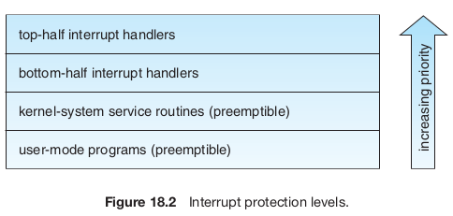
Kernel Synchronization
Critical sections in interrupt service routines --> interrupt control H/W
Disabling interrupts --> all I/O suspended --> performance degrades
Solution - Synchronization architecture – Separating ISR into:
Top half:
Standard – runs with recursive interrupts disabled
Interrupts with same number disabled – others may run
Bottom half:
Run with all interrupts enabled
Invoked automatically when an ISR exits
kernel can complete any complex processing that has to be done in response to an interrupt without being interrupted itself

Slide 10
Symmetric Multiprocessing
Linux 2.0 kernel – first stable SMP hardware
Separate processes executed in parallel on separate processors
Originally, only one processor at a time
Version 2.2, single kernel lock (big kernel lock) allowed multiple processes to be active in the kernel concurrently
Now, multiple locks – each protects a small subset of kernel's data structures

Slide 11
Memory Management
Management of Physical Memory – pages, blocks of RAM
Virtual Memory – memory-mapped into address space of running processes
Virtual Memory Regions
Lifetime of a Virtual Address Space
Swapping and Paging
Kernel Virtual Memory
Execution and Loading of User Programs
Mapping of Programs into Memory
Static and Dynamic Linking

Slide 12
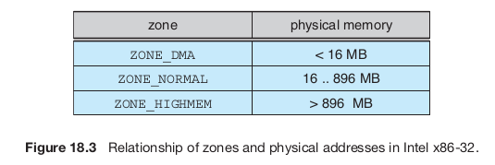
Management of Physical Memory
Linux separates physical memory into:
ZONE DMA
ZONE DMA32
ZONE NORMAL
ZONE HIGHMEM
Zones – architecture specific
Kernel maintains a list of free pages for each zone

Slide 13
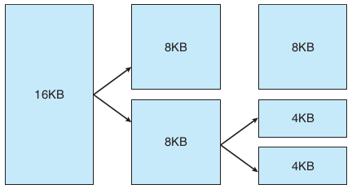
Management of Physical Memory
Page allocator
responsible for allocating and freeing all physical pages for the zone
capable of allocating ranges of physically contiguous pages on request
uses a buddy system to keep track of available physical pages
Buddy? - adjacent partner of allocatable memory region
two allocated partner regions freed up - combined to form larger region - buddy heap
converse true – subdivided into partners to satisfy request

Slide 14
Management of Physical Memory
Memory management sub-systems:
k-malloc() variable-length allocator
slab allocator, used for allocating memory for kernel data structures
page cache, used for caching pages belonging to files
Slab
used for allocating memory for kernel data structures
made up of one or more physically contiguous pages
Cache
consists of one or more slabs - populated with objects that are instantiations of the kernel DS
single cache for each unique kernel DS – ex: file objects, inodes, etc.

Slide 15
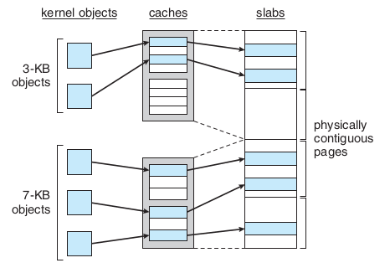
Management of Physical Memory
Slab allocation algorithm
Objects in cache are marked as free or used
In Linux, a slab may be in one of three possible states:
Full - All objects in the slab are marked as used
Empty - All objects in the slab are marked as free
Partial - The slab consists of both used and free objects

Slide 16
Management of Physical Memory
Page cache
kernel’s main cache for files
main mechanism through which I/O to block devices performed
file systems of all types perform their I/O through the page cache
stores entire pages of file contents and is not limited to block devices

Slide 17
Virtual Memory
maintains the address space accessible to each process
creates pages of virtual memory on demand
manages loading those pages from disk and swapping them back out to the disk as required
Logical view
address space consists of a set of non-overlapping regions
linked into a balanced binary tree to allow fast lookup
Physical view
hardware page tables
identify the location of each page of virtual memory, on disk or in physical memory
vm_area_struct - structure that defines the properties of each region

Slide 18
Virtual Memory
Virtual Memory region:
Backing store; describes where pages come from
Demand-zero memory
Reaction to writes - private or shared mapping of a region
Lifetime of a Virtual Address Space:
exec()
fork()
Swapping and Paging – paging system:
Policy algorithm - decides which pages to write out to disk and when to write them
paging mechanism carries out the transfer and pages data back into physical memory
Linux's pageout policy – LFU policy (least frequently used)
Kernel Virtual Memory – for internal use of Linux

Slide 19
Execution and Loading of User Programs
Older Linux kernels understood a.out format
Newer – ELF format
Mapping of programs into memory:
ELF format binary file consists of a header followed by several page-aligned sections
ELF loader works by reading the header and mapping the sections of the file into separate regions of virtual memory
Static and Dynamic Linking:
Static - necessary library functions embedded directly in the program’s executable binary file
Dynamic – stub code; contains small, statically linked function for every dynamically linked program

Slide 20
File Systems
The Virtual File System
The Linux ext3 File System
Journaling
The Linux Process File System

Slide 21
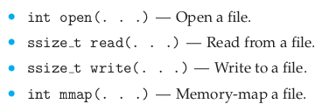
Virtual File System (VFS)
The VFS defines four main object types:
An inode object represents an individual file
A file object represents an open file
A superblock object represents an entire file system
A dentry object represents an individual directory entry

Slide 22
Virtual File System (VFS)
inode and file objects are the mechanisms used to access files
inode object - a DS containing pointers to the disk blocks that contain the file contents
file object - represents a point of access to the data in an open file
There is one file object for every instance of an open file, but always only a single inode object.
Directory – defines directory or writing data, middle all the tests
The superblock object represents a connected set of files that form a self-contained file system.
A dentry object represents a directory entry, which may include the name of a directory in the path name of a file

Slide 23
Linux ext3
Each block in a directory file consists of a linked list of entries. In turn, each entry contains the length of the entry, the name of a file, and the inode number of the inode to which that entry refers.
The default block size on ext3 varies as a function of the total size of the file system. Supported block sizes are 1, 2, 4, and 8 KB.
Allocation policies designed to place logically adjacent blocks of a file into physically adjacent blocks on disk, so that it can submit an I/O request for several disk blocks as a single operation.
Block groups, cylinder groups
While allocating, try to reduce fragmentation

Slide 24
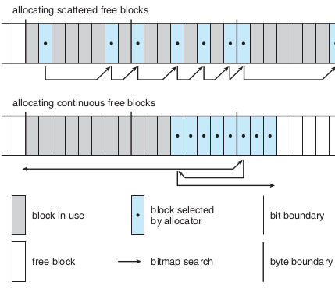
Linux ext3
Try to keep allocations physically contiguous
Search for entire free byte; then search for any free bit
Once free block identified, search extend backward until allocated block encountered
Reduces CPU cost of disk allocation by allocating multiple blocks simultaneously

Slide 25
Journaling
Modifications to the file system written sequentially to a journal.
When a committed transaction is completed, it is removed from the journal.
The journal, a circular buffer, may be in a separate section of the file system, or it may even be on a separate disk spindle.
Advantages:
Faster performance of operations
Updates proceed much faster when they are applied to the in-memory journal rather than directly to the on-disk data structures
Why? - performance advantage of sequential I/O over random I/O

Slide 26
Linux Process File System
/proc file system
contents are not actually stored anywhere
computed on demand according to user file I/O requests
Must implement two things:
A directory structure
File contents within
Mapping from inode number to information type - split into two fields:
PID
type of information being requested about the process
maintains a tree data structure of registered global /proc file-system entries

Slide 27
SUMMARY
Scheduling:
Process Scheduling
Completely Fair Scheduler
Real-Time Scheduling
Kernel Synchronization
Symmetric Multiprocessing
Memory Management:
Management of Physical Memory
Virtual Memory
Virtual Memory Regions
Lifetime of a Virtual Address Space
Swapping and Paging
Kernel Virtual Memory
Execution and Loading of User Programs
Mapping of Programs into Memory
Static and Dynamic Linking
File Systems:
The Virtual File System
The Linux ext3 File System
Journaling
The Linux Process File System

Slide 28
THANK YOU!

